Slide 1
Email Marketing
By: Dylan Smith
Period: 1

Slide 2
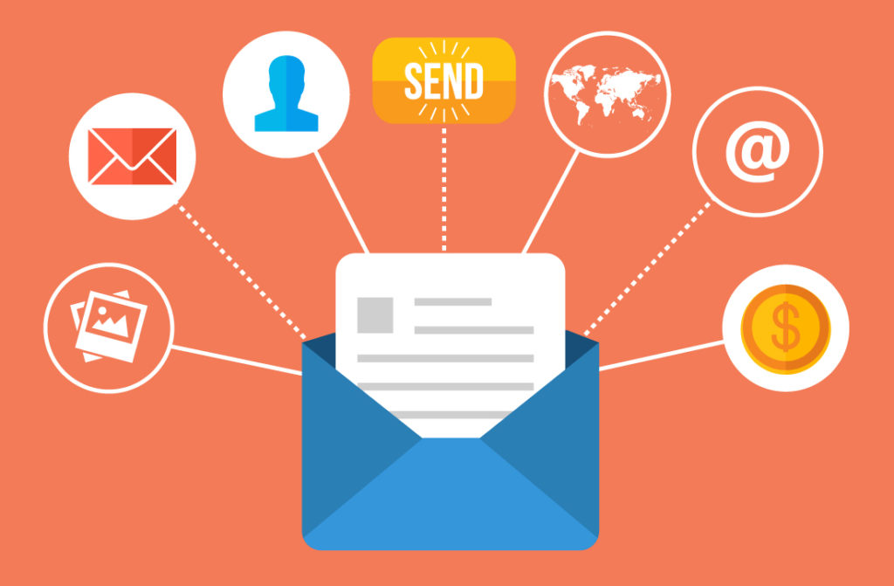
What’s Email Marketing?
Email marketing is advertising through Email

Slide 3

Why use Email Marketing?
It’s cheap, and cost effective.

Slide 4
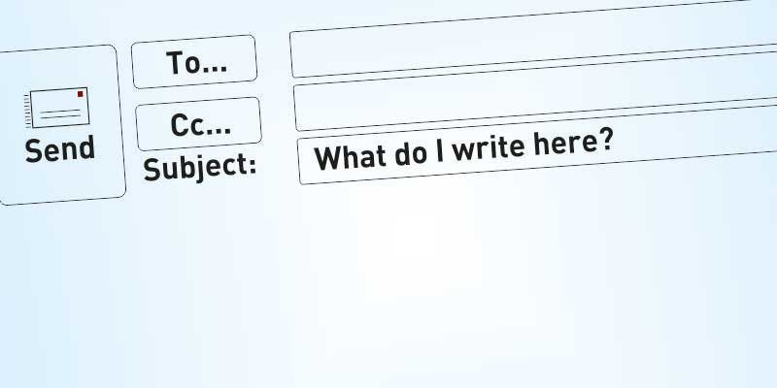
Subject Line Styles
Allows bottlenecking the majority of the Presentation.

Slide 5

Personalization
Information about viewers creates more attention.

